Slide 1

Introduction to Database Concepts
Vasugi Rajoo
03 June 2015

Slide 2
Introducing the Database
Data vs Information
Data constitute building blocks of information
Information are produced by processing the blocks of data
Good, timely and relevant information is the key to effective decision making

Slide 3
Database Management System (DBMS)
Manages database structures
Controls access to data
Contains query language

Slide 4
Importances of DBMS
Makes data management more efficient and effective
Query language allows quick answers to ad hoc queries
Provides better access to more and better managed data
Promotes integrated view of organization’s operations
Reduces the probability of inconsistent data

Slide 5


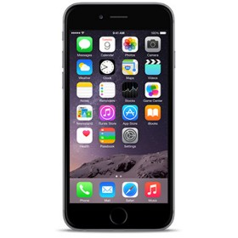
User and DBMS Interaction

Slide 6
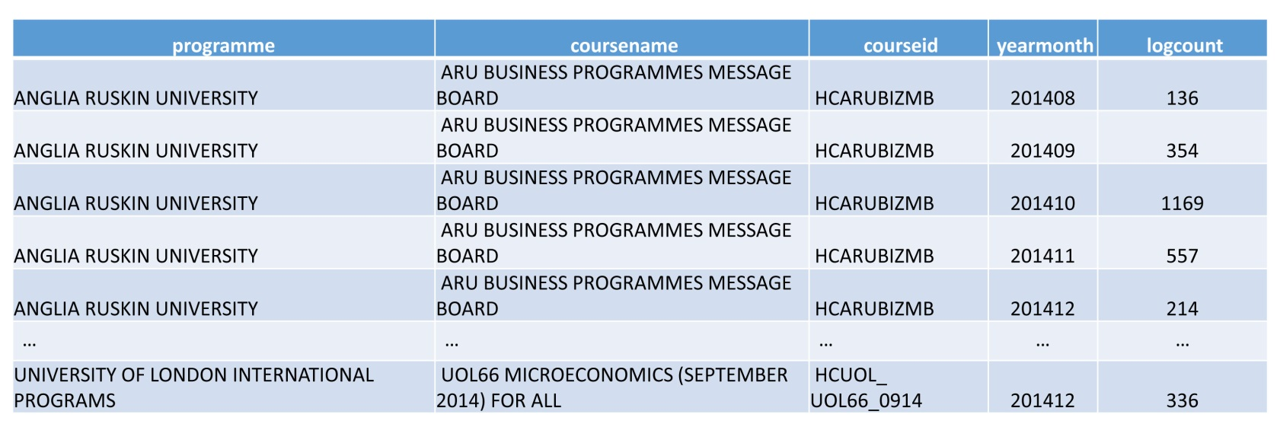
Database Terms
Data Structures
myacel_course
Table name
Data Column
Data Value
Data Row/Tuple

Slide 7
Relational DBMS (RDBMS)
table1
table2
table3
table4
All these tables are connected through “Primary keys” or “Foreign keys”

Slide 8
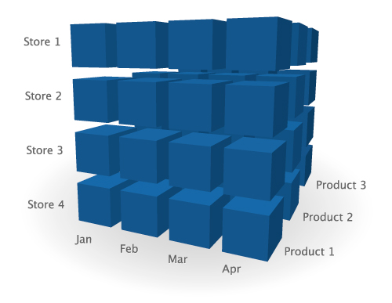
Representation of RDBMS (Data Cube)

Slide 9
Structured Query Language (SQL)
How do you inform the DBMS which data you want to insert or retrieve?
A language that can be understood by the DBMS which is structure query language (SQL).
What is query?
Using SQL to ask the DBMS a question and get the answer!

Slide 10
How does SQL Looks Like?
SELECT {what you want}
FROM {where}
JOIN {to create the data cube(s)}
ORDER BY {to sort the data}
GROUP BY {group by the categories}
INSERT {new data}
UPDATE {new value}
DELETE {old value}

Slide 11
Row-Oriented DBMS
All data are kept in row-oriented fashion

Slide 12
From Database to
Big Data

Slide 13
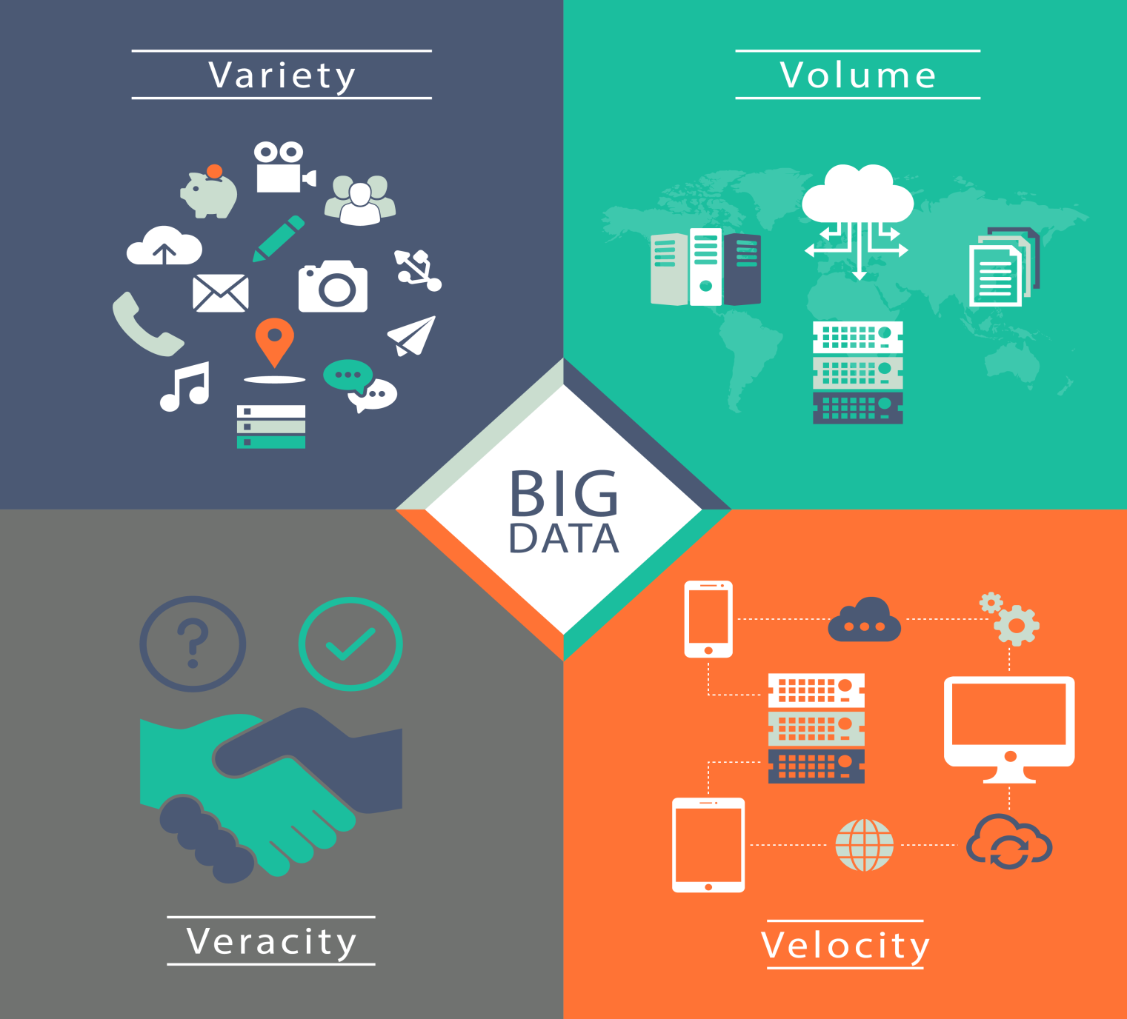
Flashback (Big Data)
4Vs
Velocity
Volume
Variety
Veracity

Slide 14
To Big Data
Data facilitates Big Data
Analytical (Velocity)
Storage (Volume)
Structured and Unstructured Data (Variety)
Authentication of Data (Veracity)

Slide 15
To Big Data
For data to facilitate Big Data, you need these:
Data Mining
Online Transaction Processing (OLTP)
Online Analytical Processing (OLAP)
C.A.P Theorem

Slide 16
Data Mining
The manipulation of data in multi-dimension such as:
SLICE
DICE
ROLL UP
DRILL DOWN

Slide 17
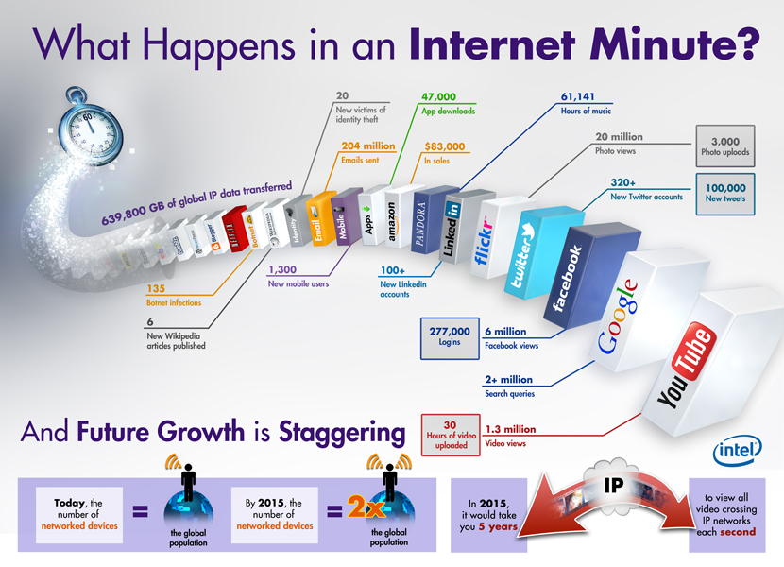
Data Mining
Advance Visualization

Slide 18
Online Transaction Processing (OLTP)
Remember SQL?
INSERT, UPDATE, DELETE
For transaction purpose
Example:
Bank transactions
System logs
Facebook user status

Slide 19
Online Analytical Processing (OLAP)
Remember SQL?
SELECT, JOIN
Questions that asked for aggregated functions:
Count, Sum, Minimum, Maximum, Average
For analytical purpose
Example:
How many users login into Facebook every minute?
How many male users are still single?
How many students are playing Clash of Clans?

Slide 20
C.A.P Theorem
Nodes (computers that provide services. i.e: processing power, storage, memory)
C – Consistency (All nodes have the same data at all times)
A – Availability (A guarantee that every request receives a response about whether it succeeded or failed)
P – Partition Tolerance (The system continues to operate despite arbitrary message loss or failure of part of the system)

Slide 21
Many Computers Work As One

Slide 22

Distributed System
Distributed system is a teamwork between computers and the software that runs on them.

Slide 23
Distributed System
1
2
3
Some tasks are too big to be handled efficiently by only one computer, even if it is a very powerful one.
A single computer is a risky single point of failure.
If you have a single computer, that machine will have to be accessed by all the users that need some of its services

Slide 24
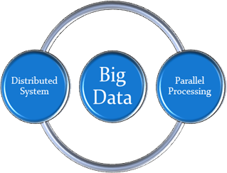
Distributed System and Big Data
A distributed system needs to be well designed in order to handle Big Data and also adapt as the need arises.
No alternatives, however:
Big Data is, in fact, too big for a single computer!

Slide 25
Parallel Processing
Parallel processing involves taking a large chunk of data, dividing it into several smaller tasks, and then working on each of those smaller tasks simultaneously.
The goal of this divide-and-conquer approach is to complete the larger task in less time than it would have taken to do it in one large chunk.

Slide 26
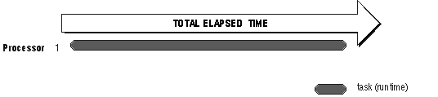
Sequential Processing

Slide 27
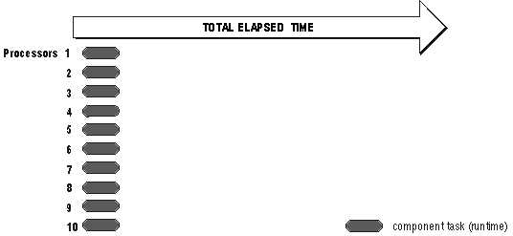
Parallel Processing

Slide 28
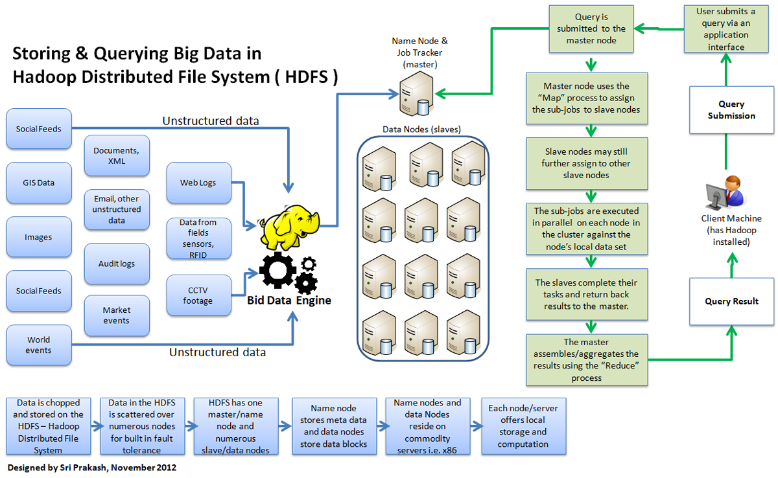
Hadoop with Parallel Processing

Slide 29
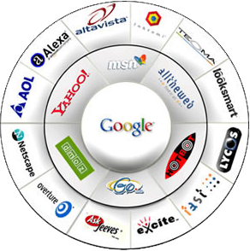

You and Cloud Computing

Slide 30
What is Cloud Computing?
Cloud computing is a colloquial expression used to describe a variety of different types of computing concepts that involve a large number of computers that are connected through a real-time communication network (typically the Internet).
Mariana Carroll, Paula Kotzé, Alta van der Merwe (2012)
Securing Virtual and Cloud Environments. In: Cloud Computing and Services Science, Service Science: Research and Innovations in the Service Economy

Slide 31
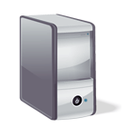



Before Cloud Computing
Traditional Business Model
Customer Info
Email
Backup
Website
Development
Intranet
Businesses
Customer

Slide 32
With Cloud Computing
Current Business Model
Email
Backup
Website
Development
Customer Info
Intranet
Cloud
Businesses
Customer

Slide 33
Open-Source Solutions

Slide 34
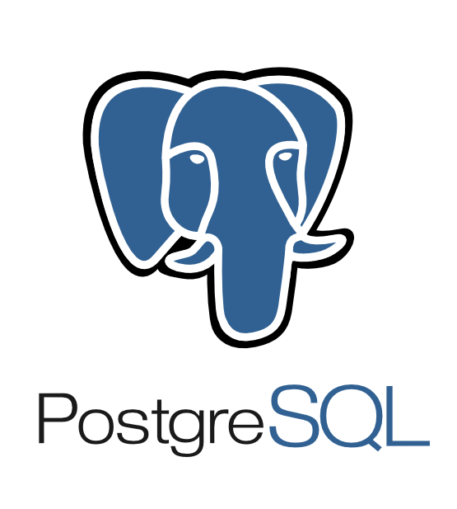



Basic Open-Source DBMS

Slide 35



Advance Open-Source DBMS

Slide 36



Open-Source Processing

Slide 37
Glossary
DBMS
SQL
Row-Oriented DBMS
Data Mining
OLTP
OLAP
C.A.P Theorem
Distributed System
Parallel Processing
Cloud Computing
Open-Source

